Slide 1
Modeling of PFC deadlock

Slide 2
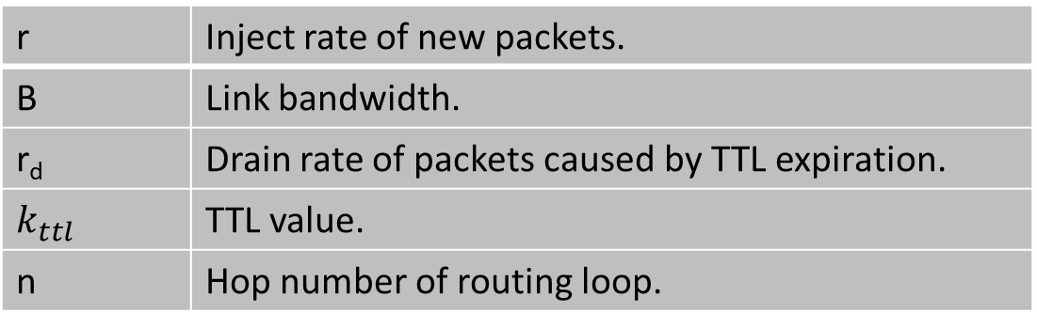
Basic model
r | Inject rate of new packets.
B | Link bandwidth.
r_{d} | Drain rate of packets caused by TTL expiration.
$$k_{ttl}$$ | TTL value.
n | Hop number of routing loop.
r
B - r_{d}
Two observations:
input rate = output rate;
The sum of TTLs of all pkts should be the fixed in a long-term view.
B

Slide 3
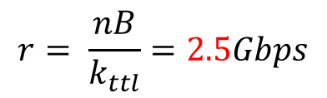
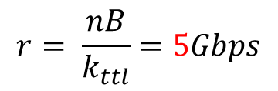
Basic model
Case 1: packets are dropped at the congestion hop (hop 1).
r
$$\left\{\begin{aligned}r+B−r_{d}=B (1) \\ n∗B=k_{ttl}∗r (2)\end{aligned}\right.$$
B - r_{d}
consuming rate of TTL
generating rate of TTL
Case 2: packets are dropped at some uncongested hop (hop k).
$$\left\{\begin{aligned}r+B−r_{d}=B (1) \\ kB+(n−k)(B−r_{d})=k_{ttl}∗r (2)\end{aligned}\right.$$
B
consuming rate of TTL
generating rate of TTL

Slide 4
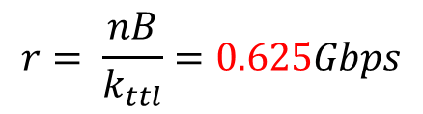
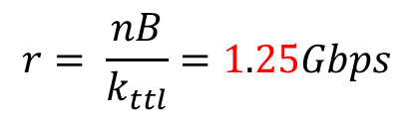
Basic model
Case 1: packets are dropped at the congestion hop (hop 1).
r
B - r_{d}
$$r= \frac{nB}{k_{ttl}}$$
Case 2: packets are dropped at some uncongested hop (hop k).
B
$$r= \frac{nB}{k_{ttl}+n−k}$$

Slide 5
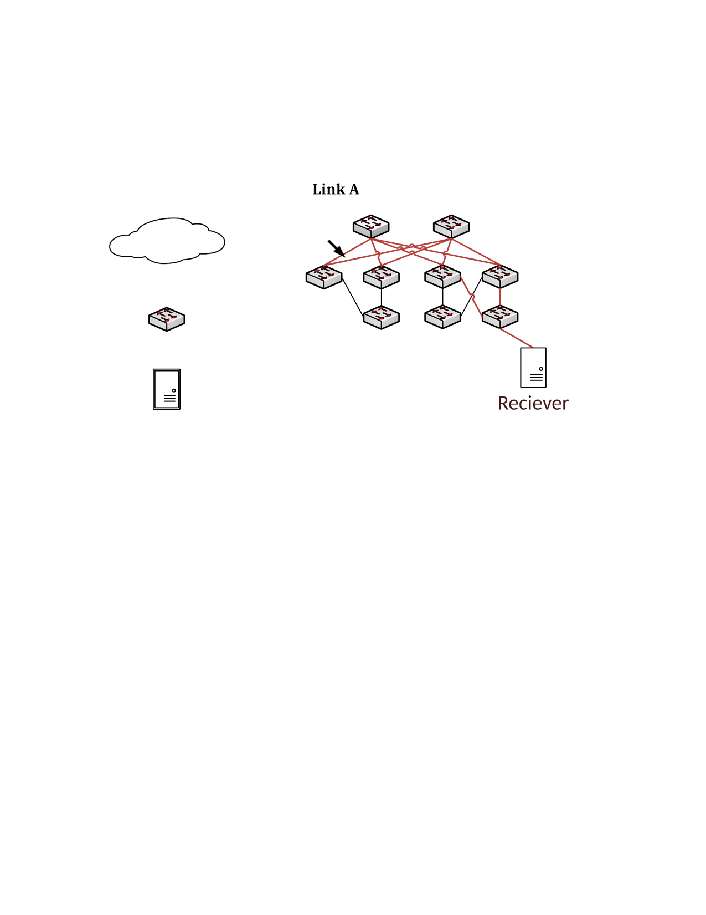
Verification of basic model
S1
S2
L1
L3
L4
172.16.4.0/31 -> T4
1
2
Lossy UDP traffic
30
30
172.16.4.5/32 -> L4
T1
T3
T4
H1: 172.16.3.6
H2: 172.16.4.5

Slide 6
Verification of basic model
TTL = 16:
Sending rate(Gbps) | 5 | 5.2 | 5.3 | 6 | 10
Queue length of l4-2-tx | 0 | 0 | 1.65MB | 1.65MB | 1.65MB
$$r= \frac{nB}{k_{ttl}}=5Gbps$$
TTL = 32:
Sending rate(Gbps) | 2 | 2.4 | 2.5 | 3 | 5
Queue length of l4-2-tx | 0 | 0 | 1.65MB | 1.65MB | 1.65MB
$$r= \frac{nB}{k_{ttl}}=2.5Gbps$$
TTL = 64:
Sending rate(Gbps) | 1 | 1.1 | 1.2 | 1.3 | 2
Queue length of l4-2-tx | 0 | 0 | 1.65MB | 1.65MB | 1.65MB
$$r= \frac{nB}{k_{ttl}}=1.25Gbps$$
TTL = 128:
Sending rate(Gbps) | 0.55 | 0.57 | 0.58 | 0.6 | 1
Queue length of l4-2-tx | 0 | 0 | 1.65MB | 1.65MB | 1.65MB
$$r= \frac{nB}{k_{ttl}}=0.625Gbps$$

Slide 7
PFC deadlock experiment-A
S1
S2
L1
L3
L4
172.16.4.0/31 -> T4
1
2
Lossless RDMA traffic
30
30
172.16.4.5/32 -> L4
T1
T3
T4
H1: 172.16.3.6
H2: 172.16.4.5

Slide 8
PFC deadlock experiment-B
S1
S2
172.16.4.5/32 -> L3
L1
L3
L4
172.16.4.5/32 -> S1
1
2
Lossless RDMA traffic
30
30
172.16.4.5/32 -> L4
T1
T3
T4
H1: 172.16.3.6
H2: 172.16.4.5

Slide 9
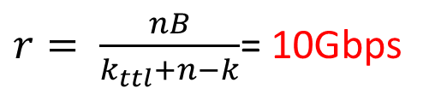
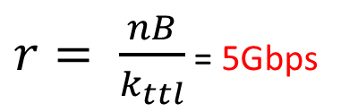
Experiment results
Experiment results of 2-hop loop:
Message size(KB) | 2.2 | 2.5 | 5 | 10 | 60
Sending rate(Gbps) | 10 | 11.5 | 22 | 38 | 40
PFC deadlock | No | Yes | Yes | Yes | Yes
sender credit | 4096 | 4096 | 4096 | 4096 | 4096
Size of sender buffer | 8.8MB | 10MB | 20MB | 40MB | 240MB
$r= \frac{nB}{k_{ttl}}$ = 5Gbps
Bytes of packets buffered in the loop when PFC deadlock occurs: 3.5MB + 2MB = 5.5MB.
Experiment results of 4-hop loop:
Message size(KB) | 3.5 | 4.1 | 4.5 | 10 | 60
Sending rate(Gbps) | 15 | 20 | 24.5 | 38 | 40
PFC deadlock | No | No | Yes | Yes | Yes
sender credit | 4096 | 4096 | 4096 | 4096 | 4096
Size of sender buffer | 14MB | 16.4MB | 18MB | 40MB | 240MB
$r= \frac{nB}{k_{ttl}+n−k}$= 10Gbps
Bytes of packets buffered in the loop when PFC deadlock occurs : 3.5MB + 2MB*3 = 9.5MB.

Slide 10
Impact of sender buffer on PFC deadlock
S1
S2
L1
L3
L4
172.16.4.0/31 -> T4
1
2
Lossless UDP traffic
30
30
172.16.4.5/32 -> L4
T1
T3
T4
H1: 172.16.3.6
H2: 172.16.4.5

Slide 11
Impact of sender buffer on PFC deadlock
TTL = 16:
Sending rate(Gbps) | 4.6 | 4.7 | 4.8 | 5 | 10
PFC deadlock | no | no | yes | yes | yes
$$r= \frac{nB}{k_{ttl}}=5Gbps$$
TTL = 32:
Sending rate(Gbps) | 1.4 | 1.5 | 1.6 | 2 | 5
PFC deadlock | no | no | yes | yes | yes
$$r= \frac{nB}{k_{ttl}}=2.5Gbps$$
TTL = 64:
Sending rate(Gbps) | 0.8 | 0.83 | 0.84 | 0.9 | 2
PFC deadlock | no | no | yes | yes | yes
$$r= \frac{nB}{k_{ttl}}=1.25Gbps$$
TTL = 128:
Sending rate(Gbps) | 0.50 | 0.55 | 0.56 | 0.6 | 1
PFC deadlock | no | no | yes | yes | yes
$$r= \frac{nB}{k_{ttl}}=0.625Gbps$$

